Slide 1


Argo: Efficient Importance Labeling for Enterprise Email Systems
Siddhant Ray, Ganesh Ananthanarayanan, Kevin Chian, Yan Guo, Cristina St Hill, Jack W. Stokes, Victor Wang, Junchen Jiang

Slide 2
Email importance labeling boosts productivity
Focus – on urgent tasks and TODOs
Track – important messages and threads
Organize – action items and data
Delete – Bulk mail, promotions etc.
Notes:
Boost productivity both for business and personal tasks
Helps us focus on important
Bulk emails which clutter the inbox
Say last :
Also if an email client offers a robust prioritize feature, this feature can help increase adoption and revenue for the product, which is good for business

Slide 3
Email labeling is a long and well studied problem
Keyword matching
(e.g., urgent, follow up)
Sender importance (e.g., designation, sending frequency)
Email properties
(e.g., CC list, email length,
time of sending, is user mentioned?)
Notes:
Looks for keywords like “I need you to do something quickly”, “Explicitly ask for follow up”
Who is the sender (is it my manager, how often do they send emails)
CC list (who else it being sent to, is a long email, am I mentioned directly)
These features are then scored, based on a heurisitic model or some classifier (could be a learn one)

Slide 4
Classical email labeling schemes are suboptimal!
Keyword matching
(e.g., urgent, follow up)
No contextual understanding -> low labeling quality!
Sender importance (e.g., designation, sending frequency)
Huge manual effort for
feature selection!
Email properties
(e.g., CC list, email length,
time of sending, is user mentioned?)
No contextual information -> Difficult to personalize
or adapt per user
Notes:
Does not look at nuances in the text (implicit contextual things are missed)
Lot of manual effort to select the list of features
Feature space is very large, hard to personalize a subset of features for different people, and hard to learn this signal
How to choose what feature is important for which user
Effectively a very large one hot encoding matrix to learn
Will show some examples later

Slide 5
LLMs are a natural fit for email labeling
SOTA language modeling technique with deep contextual understanding -> high quality labeling
Emails are almost exclusively in natural language (only some metadata is not e.g., timestamps)
LLMs directly take in text input and do not require manual input feature selection
Notes:
Say at end:
LLMs are a great fit for this problem as this is what they are trained to do – understand the complexities of natural language
We aren’t trying to use LLMs for out of domain tasks

Slide 6
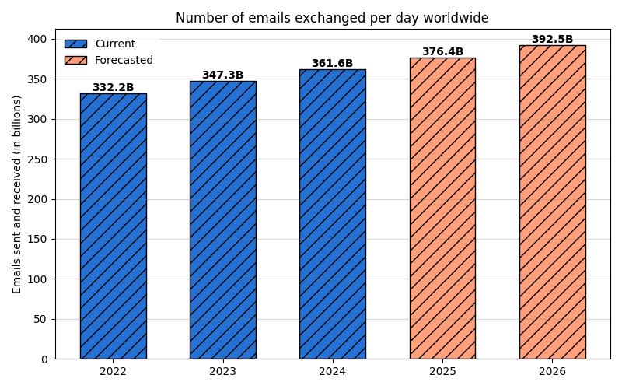
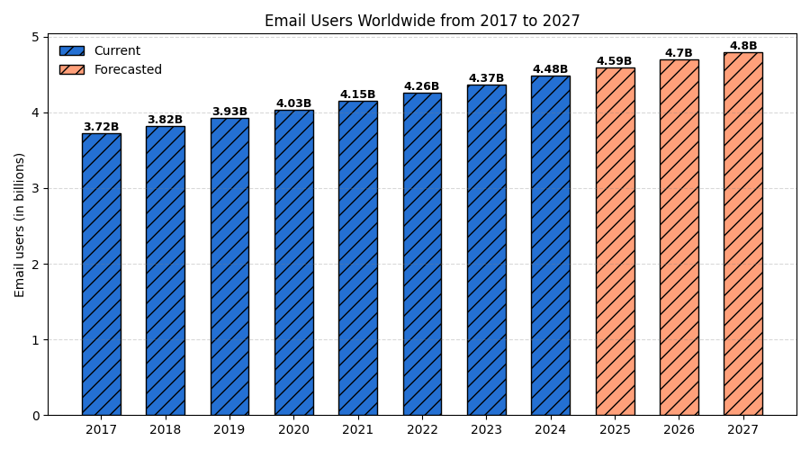
Email is an extremely high-volume application
Running GPT for even 1/10th of the emails -> labeling cost is O(billion USD)
Significant dent in Outlook’s budget to label even 10% emails with current GPT4.1 API costs
Figure source: www.statista.com
Notes:
So all great? No…..
High volume drives up cost
Figure on left and then figure on right
Outlook is a major email client, so a large fraction of this will be through outlook

Slide 7
Can we have near-GPT labeling quality at lower cost?
How can we approximate GPT labeling with cheaper models?
How do we efficiently provision resources for such labeling?

Slide 8
Email labels can have different specificities
Priority label ( Multi-label 1 (lowest) – 5 (highest) )
Needs Reply label ( Binary 0 / 1 )
Is Urgent label ( Binary 0 / 1 )
Needs Action label ( Binary 0 / 1 )
Needs Scheduling label ( Binary 0 / 1 )
Notes:
Do I need to schedule a meeting/chat/follow-up (time-sensitive event) or not
These labels have also been discussed with the Outlook team and are ones which are needed in their client
Extensible list, can add more labels at any point

Slide 9
Measurement study : The Enron Email Dataset
137 unique users, senior management at Enron Inc.
Each user has:
  Inbox (we sample emails from here)
  40000 emails in total
Emails are labeled with :
  GPT4.1 (Baseline model in Outlook)
  Multiple labels considered
Dataset Source: https://www.cs.cmu.edu/~enron/
Notes:
I will now present a measurement study we conducted on emails from Enron, on the occurrence and examples of such email labels
First lets talk about the email dataset Enron
Availability and size
Fauci
Donated emails

Slide 10
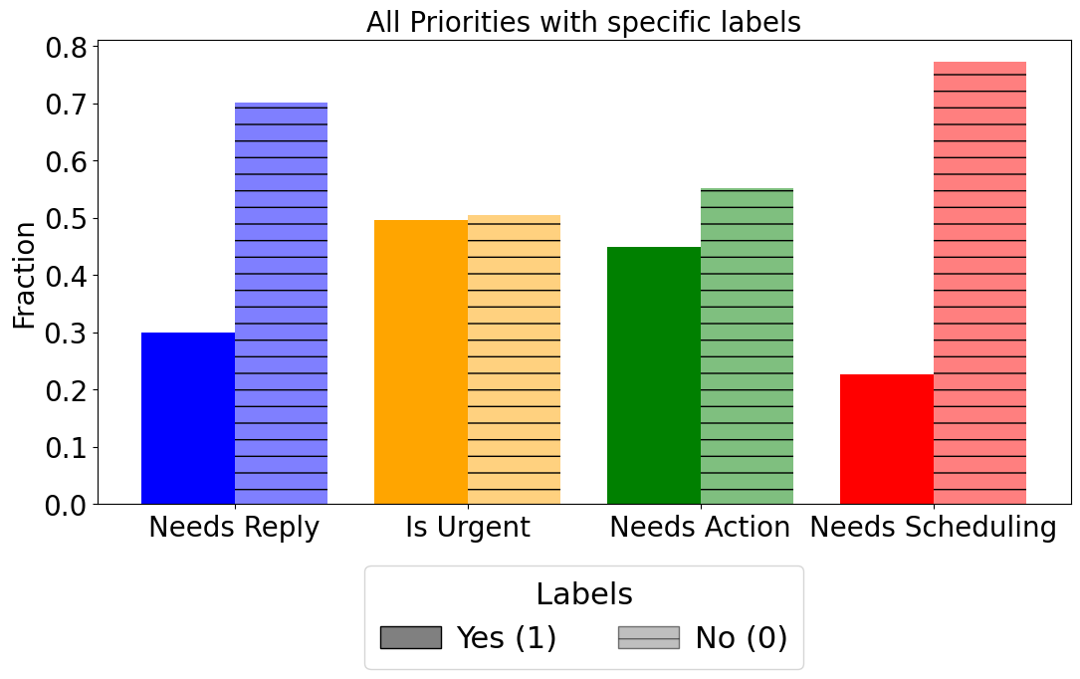
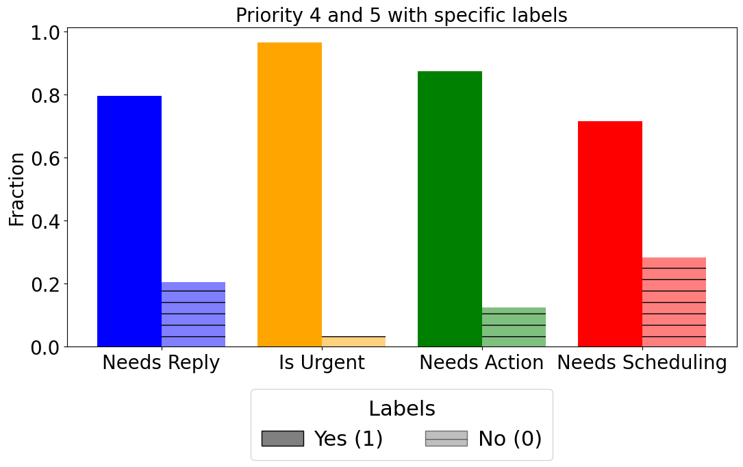
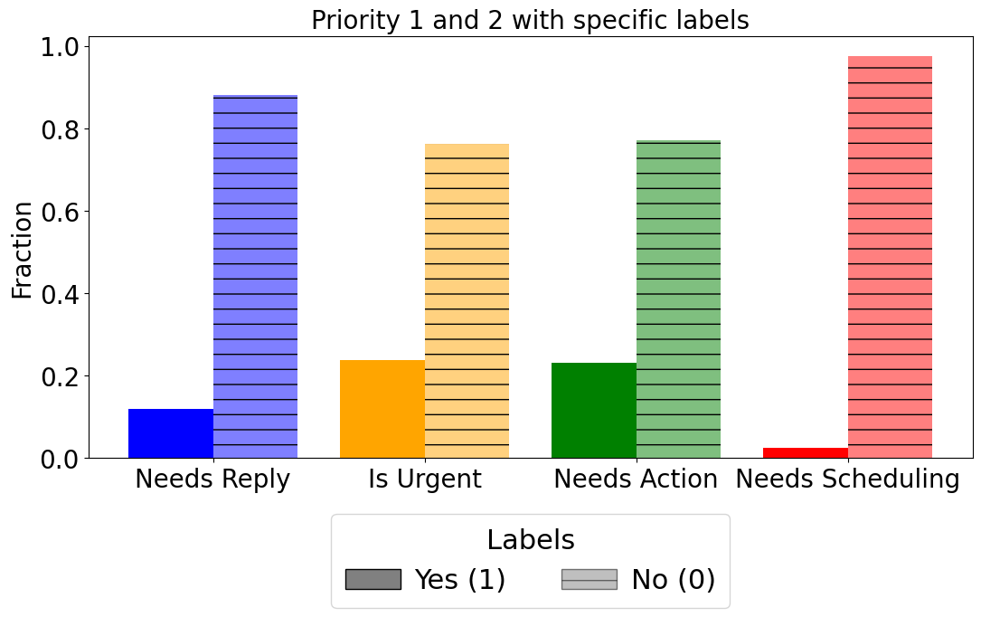
Not all label distributions occur in practice
Notes:
I will now present some label distributions to show what kinds of label combinations occur in practice
Separation is between binary and non-binary.
We fix the priority label (non-binary) and measure the distribution of binary labels
Y axis is the fraction of the label
X axis is the binary label
For given priority label
Priority is on scale 1 - 5
Call 4 and 5 is high
1 and 2 is low

Slide 11
Priority - 4, Needs Reply - 1
Date: Thu, 20 Dec 2001 12:31:26 -0800 (PST)
From: carol.st.@enron.com
To: credit <.williams@enron.com>
Subject: Mirant exposure relationship
Cc: edward.sacks@enron.com, elizabeth.sager@enron.com
Jay:
We have received termination letters from Mirant covering the following:
1 .Letter dated 11/30 from Mirant Americas Energy Marketing LP covering (a) 5/11/99 Master Coal Purchase and Sale Agreement; (b) 1/1/99 Coal Purchase and Sale Agreement; (c) 11/1/92 Master Firm Purchase and Sale Agreement; (d) GISB confirms; and (e) emission transaction confirms with ENA, ENA II Corp., EGM, EPMI, ERMS and ENA Upstream.
2. Letter dated 11/28 from Mirant Americas Energy Marketing LP covering (a) 4/1/97 Master energy Purchase and Sale Agreement; (b) 1/1/96 GISb; and (c) 6/1/94 ISDA.
3.Letter dated 11/30 from Mirant Canada Energy Marketing Ltd. covering all transactions for the sale and purchase of natural gas.
Do these letters cover all of the Mirant relationships? What does the collateral hat they are holding cover? In the US, are we only out of the money on the EPMI trades?
Carol St. Clair
EB 4539
713-853-3989 (phone)
281-890-8862 (home fax)
carol.st.clair@enron.com
Notes:
Email on business termination letters
Email asks for reply implicitly and asks many questions

Slide 12
Date: Wed, 2 Jan 2002 17:15:10 -0800 (PST)
From: arsystem@mailman.enron.com
To: louise.kitchen@enron.com
Subject: Your Approval is Overdue: Access Request for
tammie.schoppe@enron.com
This request has been pending your approval for 87 days. Please click http://itcapps.corp.enron.com/srrs/auth/emailLink.asp?ID=000000000058213&Page=Approval to review and act upon this request.
Request ID : 000000000058213
Request Create Date : 9/5/01 1:07:01 PM
Requested For : tammie.schoppe@enron.com
Resource Name : Global Messaging North America Additional Mailbox Space (25 Meg Increase)
Resource Type : Applications
Priority - 2, Needs Action - 1
Notes:
A system ticket , sent from a mailman
Low priority email (already has been waiting for 87 days) but requires an approval on an explicit item

Slide 13
Priority - 2, Urgent - 1
Date: Fri, 2 Nov 2001 08:43:14 -0800 (PST)
From: jessica.presas@enron.com
To: barry.tycholiz@enron.com, stephanie.miller@enron.com, houston <.ward@enron.com>, phil.polsky@enron.com, mara.bronstein@enron.com
Subject: Move Info
There is only 1 week left before moving into the new building. There are two shredco containers located at EB3206E and in the freight elevator for documents that need shredding. Also there will be a couple of large trash containers located on the 32nd floor today 11/2/01 and next Friday 11/9/01. Please start the cleanup process.
Remember:
1. You can only move 6 boxes per person plus equipment
2. Take home all IPAQ'S, Blackberry's, Palm Pilots and Laptops Friday 11/9/01 so that nothing is misplaced
3. If you have a cellular phone charger on your desk....don't forget to pack
4. Clean out all Voicemails by 5:00 PM on Friday 11/9/01
5. The new Enron Building will be closed to all until 5:00 AM on Monday Morning. If you try to come up here, you will not be allowed in the building.
6. Please give your User ID and Password to your assistant so she/he can make sure that everything is up and running for you on Monday morning.
7. If you have a headset, please pack it. They will not be installed until Monday morning.
8. Since there are no amtels moving, please be sure you have MSN messenger installed in your computer because this is what your assistant will use to give you your messages. If you do not have it, your assistant can help you install it.
9. Please label your PC, Boxes (on the ends), and cradles, scanners, etc. You will have a new mouse and keyboard in the new building and your monitors will have speakers on them so you don't have
If you have any other questions or concerns, please let me know.
Many thanks!
Ina Rangel
Administrative Coordinator
Enron North America
713-853-7257 Voice
Notes:
Task needs to be carried out in 1 week so urgent
Not super high priority as it is a moving out check list (not a critical business need)

Slide 14
Outline: Multiple schemes for email labeling
Notes:
We will now move to low-cost schemes for email labeling , as opposed to using GPT only

Slide 15
Scheme 1: SLM Cascades for Email Labeling
Priority label
High quality across ALL labels
Needs Reply label
Is Urgent label
All labels
Needs Action label
Cascaded SLM Inference
Inference for multiple labels increases cost
Needs Scheduling label
Combining labels leads to ~15% quality drop
Notes:
Multiple cascades increases cost
Labels cannot be combined

Slide 16
Scheme 2: Embeddings + Classifier for Email Labeling
Priority label
Cost is 500X lower as embeddings are reusable across labels
Needs Reply label
Is Urgent label
All labels
Needs Action label
Embedding based MLP classifier
Needs Scheduling label
Low quality (~15-20% drop) for non-binary labels due to high class imbalance during training
Notes:
What if we used embeddings + a classifier?
10-15% drop in quality

Slide 17
Argo: Hybrid Scheme for Email Labeling
Label
Priority label
Cascaded SLM Inference
Needs Reply label
Is Urgent label
Labels
Needs Action label
Needs Scheduling label
Embedding based MLP classifier
Notes:
Make it explicit that its not label
And how do we get to this hybrid solution?
We build a profiler

Slide 18
Profiling helps us build this hybrid solution
M1
M3
Subset
of SLMs
Email set for calibration
Argo’s Profiler
Order
of cascade
M1
M2
M3
M4
Labels for cascade
List of SLMs
Labels for embedding
T1
T2
T3
T4
T1
T4
Subset
of thresholds
All Labels
List of thresholds for cascade
Notes:
First build the profiler step by step
At the end:
I will now show both parts of the hybrid solution , the SLM cascade and the embedding in more detail

Slide 19
Choosing pareto-front operating points for Argo
Quality-Focus
The dashed line is
the Pareto-Front
Norm. Quality
Balanced
Cost-Focus
Norm. Cost Reduction
Balanced (Default) – Maximizes the sum of the normalized quality and normalized cost reduction factor.
Quality-Focus – 75%-25% weightage to normalized quality and normalized cost reduction factor respectively.
Cost-Focus – 25%-75% weightage to normalized quality and normalized cost reduction factor respectively.

Slide 20
Cascaded SLM inference for Priority Label
Phi-4-
mini-instruct
Llama-3.1-
8B-Instruct
gemma-3-
27b-it
Qwen2.5-
32B-Instruct
Llama-3.3-
70B-Instruct
0
100
0
100
0
100
0
100
0
100
Priority label
(1 - 5 )
0
100
: Token log probs -> 0 to 100 linear confidence scale
Notes:
We fall back and select the output of the most expensive model in the cascade, as we already have all the labels
Our profiling showed larger models have higher quality on average.
why these models? Based on profiling
How do we actually get the parameters for building the cascade? Based on profiling

Slide 21

Embedding based classifier for binary labels
Offload to CPU
> 4X cost savings per hour (USD)*
Frozen embeddings
text-embedding-3-large
MLP classifier
Binary label
Weight Decay
Reused across labels
Hyperparameter tuning
OneCycle LR Scheduling
Dropout
* Azure A100 GPU server vs EPYC 7V13 CPU server
Notes:
Hyper parameter tuning improved performance

Slide 22
Argo’s profiler can constrain to operator-specific SLMs
Phi-4-
mini-instruct
Mistral-7B-Instruct-v0.3
Operator says – I only want to use these
4 SLMs due to business and
licensing requirements!
DeepSeek-R1-Distill-Qwen-32B
Qwen2.5-
32B-Instruct
Notes:
Part 1: Profiler can be constrained with a set of models
Profiling based on constraints can still provide the best parameters from the SLM cascade space
For example, we can have a constraint on set of models used (like Outlook can only use certain models)

Slide 23
Argo can tune cascade to operator constraints
Phi-4-
mini-instruct
Mistral-7B-Instruct-v0.3
DeepSeek-R1-Distill-Qwen-32B
Qwen2.5-
32B-Instruct
0
100
0
100
0
100
0
New SLM cascade with operator compliance!
100
Priority label
(1 - 5 )
0
100
: Token log probs -> 0 to 100 linear confidence scale
Notes:
Constraints can also be number of models in the cascade

Slide 24
Argo’s profiler helps choose the confidence threshold
T1
T2
T3
T1 labels
T2 labels
GPT-4.1 labels
Quality
T4
T5
T6
T3 labels
T4 labels
Cost Reduction
T5 labels
T6 labels
Threshold values chosen with points on the Pareto Front
Notes:
Pareto front of the cost quality tradeoff

Slide 25
Controlling the cost of our profiler
Profile one-time on large email set
Periodic (Change in log-prob distributions)
Explicit user feedback (Outlook has this feature)
Re-profiling with GPT labels
Resource availability based (Non-peak time)
User profile based (Use org chart)
Independence of profiling knobs
Cascade ordering and threshold selection can be decoupled
Notes:
This profiling can get expensive, so we have some thoughts and methods to reduce the profiling costs
Periodic (log prob distribution shift)
Who is the user -> importance (decide profiling)
User tell me I need better quality
Resource availability based (do it when resources are free)
EVP vs intern

Slide 26
How to minimize cost of the cascade under load?
Phi-4-
mini-instruct
Llama-3.1-
8B-Instruct
gemma-3-
27b-it
Qwen2.5-
32B-Instruct
Llama-3.3-
70B-Instruct
0
100
0
100
0
100
0
100
0
100
Cost 1 : Provisioning cost for each instance (w/ penalty factor if limit exceeds)
Priority label
(1 - 5 )
Cost 2 : Per request processing cost (SLMs ordered by increasing cost)
0
100
: Token log probs -> 0 to 100 linear confidence scale

Slide 27
How to minimize cost of the cascade under load?
Phi-4-
mini-instruct
Llama-3.1-
8B-Instruct
gemma-3-
27b-it
Qwen2.5-
32B-Instruct
Llama-3.3-
70B-Instruct
0
100
0
100
0
100
0
100
0
System chooses to use gemma-3-27b to label but it is at capacity!
100
Choice 1 : Provisioning a new gemma-3-27b instance (w/ penalty)
Choose option with
lower cost increase!
Priority label
(1 - 5 )
Choice 2 : Go up and unused capacity from Qwen32B or LLama70B
0
100
: Token log probs -> 0 to 100 linear confidence scale

Slide 28
Emails Need Labels for Evaluation (e.g., on Enron)
8000 emails sampled across users for threshold calibration and classifier training
800 emails sampled across users for evaluation
Priority (1 - 5)
Needs Reply (0 - 1)
Labeled with GPT 4.1 (baseline model*)
Is Urgent (0 - 1)
Needs Action (0 - 1)
Needs Scheduling (0 - 1)
*Baseline is current Outlook’s production model in the Prioritize client
Notes:
Now I will talk about our evaluation

Slide 29
How we compare costs for different SLM/LLMs?
Phi-4-mini-instruct
Deepseek-R1-Distilled
105X cheaper
20X cheaper
Llama-3.1-8B-Instruct
Qwen2.5-32B-Instruct
100X cheaper
15X cheaper
gemma-3-27b-it
Llama-3.3-70B-Instruct
90X cheaper
10X cheaper
Token costs relative to GPT4.1 measured in USD on Azure AI
Notes:
Wide range of models with different sizes and costs relative to GPT
We have models which are around 100X cheaper
We have models which are around 10X cheaper

Slide 30
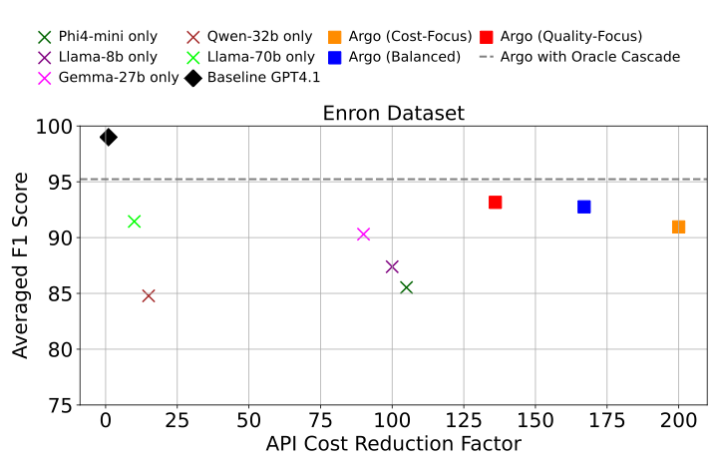
Argo achieves cost-reduction at equivalent quality
167X cheaper, within 6% F1-score of GPT
Better

Slide 31
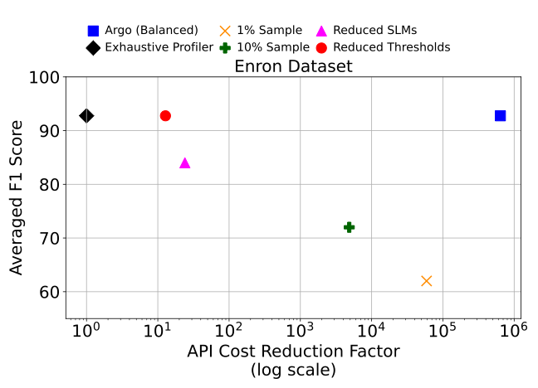
Argo’s profiler is efficient at choosing knob values
Better

Slide 32
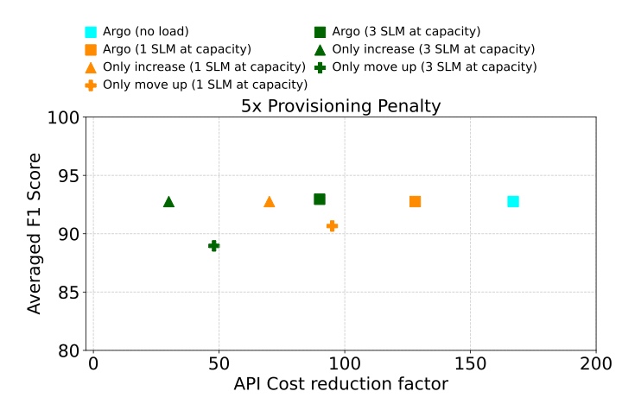
Argo minimizes cost increases during peak load
Better

Slide 33
Conclusion
Cost-efficient labeling: Matches GPT-4.1 labeling quality while reducing inference cost by 148–167X.
Efficient profiling: Argo identifies strong cost–quality configurations with 20–640,000X lower profiling cost.
Load-aware provisioning: Scales with real-time demand to limit peak-load cost increases and enable practical enterprise deployment.

